Slide 1











CRMsDataSpace
Common European Data Space on Critical Raw Materials for the Green Deal: Recovery Potential from Closed Extractive Coal Waste Facilities
Coordinator: Alicja Krzemień. Central Mining Institute - National Research Institute (GIG-PIB)
Call:​ RFCS-2024-01-RPJ
Start date:​ 01/07/2025
End date:​ 30/06/2028
Total costs: 3 966 876 €

Slide 2
Problem identification
Recovering critical raw materials from closed extractive waste facilities can create economic value and employment in historical mining regions, explicitly supporting the just transition of the coal sector and regions highly affected by deindustrialisation and decline.
To address the current lack of information on the potential of closed extractive waste facilities for critical raw materials, the CRMA requires each MS to establish a database containing all relevant information to promote the recovery, particularly the quantities and concentrations of critical raw materials in the closed extractive waste facilities.
As MS are expected to use existing databases from their national geological services or European-wide databases, both created for purposes other than the ones pursued by the CRMA, this will cause severe dysfunctions using tools developed with different objectives, different languages among MS, and prevent comparisons at the EU level.
Notes:
To ensure the accessibility of this presentation to blind users who use a screen reader,
if you translate this presentation or include parts not in English, make sure the proofing language is set to the right one (Review > Language > Set proofing Language). This will make sure the screen reader uses the right pronunciation.

Slide 3
Project overview
Project Description:
Provide National Authorities in Member States with a tool to comply with the requirements of the Critical Raw Materials Act (CRMA) regarding information about CRM's potential in closed extractive waste facilities.
Develop multi-sided business solutions for the CRM ecosystem that leverage network effects, catering to both the "supply" and "demand" of data and creating data-related services.
Implement Artificial Intelligence (AI) reporting tools using Large Language Models to generate reports automatically.
Feed the ecosystem with information from closed extractive coal waste facilities to exemplify assessing the critical raw materials recovery potential by multiple options.
Notes:
To ensure the accessibility of this presentation to blind users who use a screen reader,
if you translate this presentation or include parts not in English, make sure the proofing language is set to the right one (Review > Language > Set proofing Language). This will make sure the screen reader uses the right pronunciation.

Slide 4
Project overview
Technology Development: Predecessor EU projects that have led to the current state of technology advancement include, e.g., the European Marine Observation and Data Network (EMODnet) and the European Geological Data Infrastructure (EGDI).
Novelty of Approach: Building a Common European Data Space on critical raw materials is the optimal way to fulfil the information requirements imposed by the CRMA while giving them a real European dimension. Data exchange across organisations or Member States is currently constrained by proprietary, non-transparent, non-interoperable technologies that do not provide the necessary level of trust.
Expected final TRL: CRMsDataSpace's research activities will start at TRL 2 (Technology concept and/or application formulated) and achieve TRL 5 (Technology validated in lab—component and/or breadboard validation in relevant environment) by the end of the project.
Notes:
To ensure the accessibility of this presentation to blind users who use a screen reader,
if you translate this presentation or include parts not in English, make sure the proofing language is set to the right one (Review > Language > Set proofing Language). This will make sure the screen reader uses the right pronunciation.

Slide 5
Project results
Breakthroughs and innovations:
It will be the first data catalogue that leverages metadata and data management tools focused on critical raw materials.
It will ensure data exchange, integration, and analysis between CRM stakeholders by developing and deploying a data space platform aligned with the principles governing European data spaces.
It will develop multi-sided business solutions for the CRM ecosystem.
It will implement Artificial Intelligence (AI) reporting tools using Large Language Models (LLMs).
It will implement an Artificial Intelligence tool to classify CRMs from closed extractive waste facilities according to the United Nations Framework Classification for Resources.
It will deploy an operational Common European Data Space on Critical Raw Materials for the Green Deal supported by CRMsDataSpace.
Notes:
To ensure the accessibility of this presentation to blind users who use a screen reader,
if you translate this presentation or include parts not in English, make sure the proofing language is set to the right one (Review > Language > Set proofing Language). This will make sure the screen reader uses the right pronunciation.

Slide 6
Project impact​
Alignment with EU Priorities:
The proposal will leverage the European coal sector's key competitive advantage, creating sources of wealth from problems such as coal waste heaps that will become solutions for the critical raw materials value chain.
After extracting CRMs, the proposal will contribute to land rehabilitation and ecological restoration of these coal mining-affected areas, which are, in many cases, currently degraded.
It will also help protect the most vulnerable workers in the transition by making a vital contribution to the territories expected to be the most negatively impacted by the climate transition.
It will increase the alternatives in the European Coal sector after the phasing out of coal by the possibility of repurposing former coal-washing treatment installations into mineralurgical / hydrometallurgical mineral processing facilities focused on critical raw materials.
Notes:
To ensure the accessibility of this presentation to blind users who use a screen reader,
if you translate this presentation or include parts not in English, make sure the proofing language is set to the right one (Review > Language > Set proofing Language). This will make sure the screen reader uses the right pronunciation.

Slide 7
Project impact​
Socio-Economic Impact:
Societal effects: to attract investment, innovation, and jobs to former mining regions, which are usually depressed following the loss of this economic activity.
Economic effects:
  To allow potential project promoters to quickly identify facilities with a high potential for economically viable recovery all around Europe without having to correspond with authorities, with uncertainty surrounding access to confidential information.
  To facilitate the development of new projects by the interested companies and the emergence of junior mining companies that use their money and efforts to undertake new mining projects.
Environmental effects: reducing the number of new mining exploitations in Europe and, thus, reducing the environmental effects caused by mining activities; and contributing to the adequate land rehabilitation and ecological restoration of many degraded areas abandoned in the past without undergoing adequate reclamation
Notes:
To ensure the accessibility of this presentation to blind users who use a screen reader,
if you translate this presentation or include parts not in English, make sure the proofing language is set to the right one (Review > Language > Set proofing Language). This will make sure the screen reader uses the right pronunciation.

Slide 8
Lessons learnt​
Key takeaways: Meeting with Directorate General for Internal Market, Industry, Entrepreneurship and SMEs (DG GROW).
On Article 27, the Commission has drafted guidelines on how member states can best comply in a way that yields a useful, pan-European tool to show where recovery opportunities lie. DG GROW wants to avoid a situation in which each member state does its own thing.
DG GROW pointed out that Project partners should consider how the envisaged database might be quickly and efficiently populated with geolocation data for all coal waste facilities in a small sample of member states.
DG GROW will provide CRMsDataSpace with a contact point for the coordinator of the working group on Circularity and will share information on the CRMsDataSpace project with the members of the working subgroups on Exploration and Circularity. Once the project is more advanced, DG GROW could consider organising a dedicated presentation of the CRMsDataSpace project for both working subgroups.
Notes:
To ensure the accessibility of this presentation to blind users who use a screen reader,
if you translate this presentation or include parts not in English, make sure the proofing language is set to the right one (Review > Language > Set proofing Language). This will make sure the screen reader uses the right pronunciation.

Slide 9
Next steps​
Implementation Roadmap:
Direct contact with key stakeholders: A list of key stakeholders will be compiled. They will receive information about the database's contents and tools directly. Also, 27 National Authorities will be directly contacted to present the database features.
Feedback to the Policy Framework: To further develop the initiated Common European Data Space on Critical Raw Materials for the Green Deal, complementing this ecosystem with aspects related to the distribution and content of critical raw materials in mineral deposits, critical raw materials residues, etc.
New Collaborations:
The consortium will also seek associations and other stakeholders interested in specific developments of the Common European Data Space on Critical Raw Materials for the Green Deal, offering their knowledge to implement aspects mainly related to information services: CRMs in the battery value chain, CRMs in vehicles, Foreign direct investment (FDI) stocks and flows, E-waste, CRMs profiles, EU funded projects, Green energy and transport, etc.
Notes:
To ensure the accessibility of this presentation to blind users who use a screen reader,
if you translate this presentation or include parts not in English, make sure the proofing language is set to the right one (Review > Language > Set proofing Language). This will make sure the screen reader uses the right pronunciation.

Slide 10
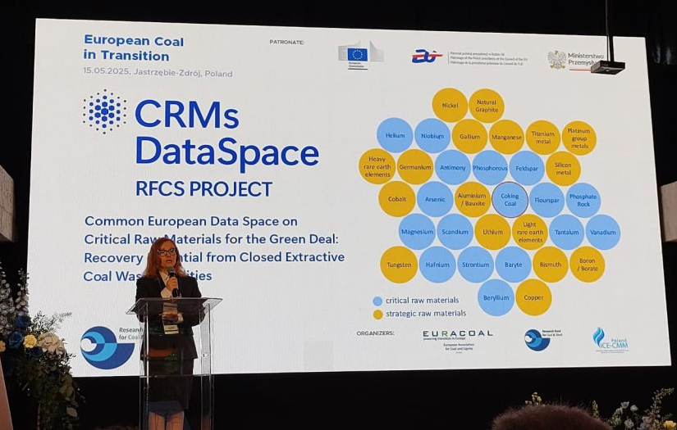
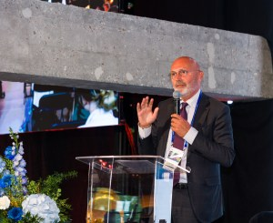
Next steps​
Knowledge Sharing: High-level RFCS Event “European Coal in Transition: from an industrial legend to cutting-edge research for the future” organised by EURACOAL and the European Commission’s Research Executive Agency (REA) (Carbonarium, Jastrzębie-Zdrój, Poland, 15 May 2025).
Notes:
To ensure the accessibility of this presentation to blind users who use a screen reader,
if you translate this presentation or include parts not in English, make sure the proofing language is set to the right one (Review > Language > Set proofing Language). This will make sure the screen reader uses the right pronunciation.

Slide 11
Towards industrial application​s
Potential applications beyond project targets:
Member States: CRMsDataSpace partners will offer Member States a centralised contact point service provision, which will be optimal from an economic point of view.
Consultancy services: provided on using the project's output to develop point clouds, 3D models, and interpolations related to the resource estimation of the closed extractive waste facilities, including information related to variograms and block models.
Training on the multi-sided business solutions: (1) The access interface to provide data; (2) The GIS web portal; (3) The app for mobile devices aimed at automating the acquisition of GPS georeferencing data; and (4) The Artificial Intelligence (AI) tools.
New developments from the previously mentioned multi-sided business solutions.
Intellectual property strategy: a Consortium Agreement was set up to manage (amongst other things) ownership and access to crucial knowledge (intellectual property rights -IPR-, research data, etc.)
Notes:
To ensure the accessibility of this presentation to blind users who use a screen reader,
if you translate this presentation or include parts not in English, make sure the proofing language is set to the right one (Review > Language > Set proofing Language). This will make sure the screen reader uses the right pronunciation.

Slide 12
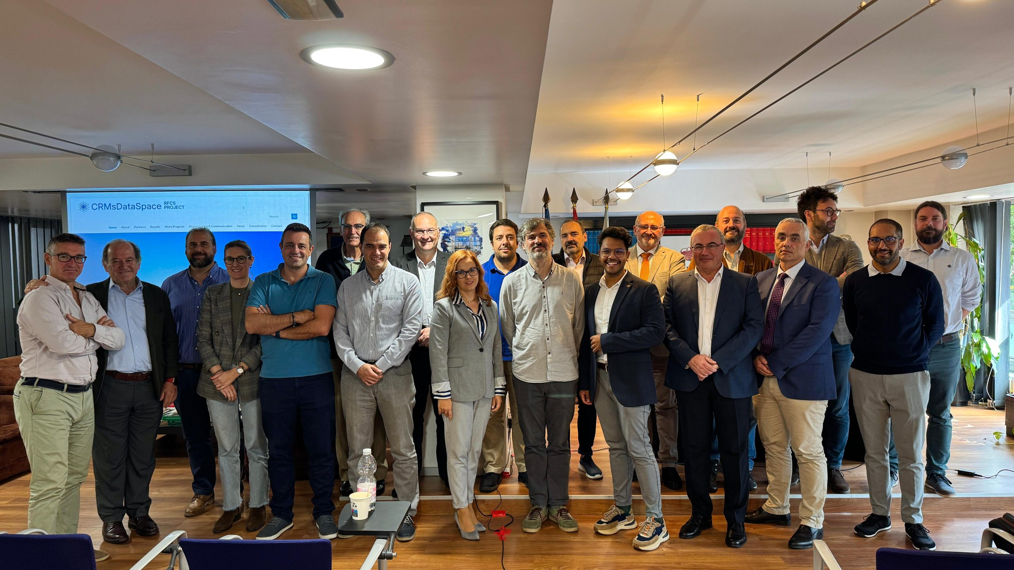
Thank you for your attention!
Pedro Riesgo Fernández, University of Oviedo
12

